Slide 1
ADVOCACY FOR GREEN ENERGY

Slide 2
01
Wind
02
Solar
Advocacy For Green Energy
03
Tidal
04
Biomass
05
Nuclear
06
Geothermal
07
Hydroelectric

Slide 3
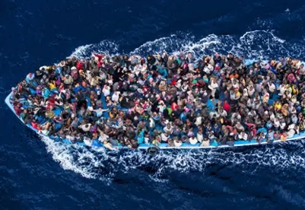
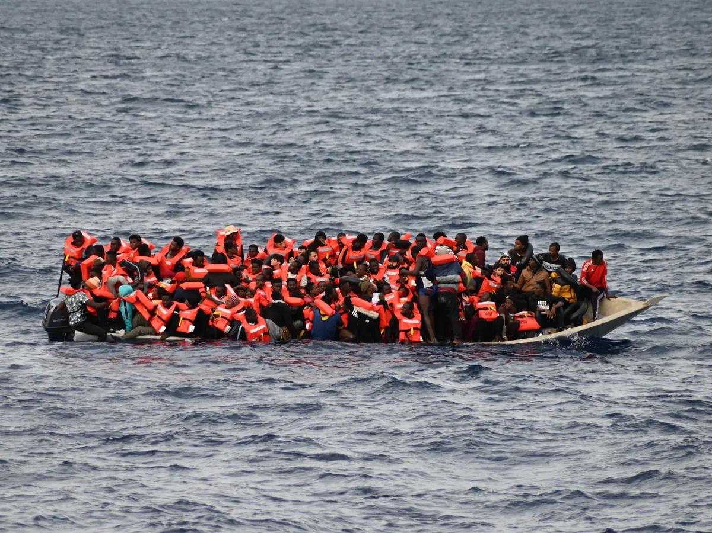
Rome Statute of the International Criminal Court
Article 7
Crimes Against Humanity
For the purpose of this Statute, ‘crime against humanity means any of the following acts when committed as part of a widespread or systematic attack directed against any civilian population, with knowledge of the attack:
k. Other inhumane acts of a similar character intentionally causing great suffering, or serious injury to body or to mental or physical health.
Advocacy For Green Energy

